Slide 1
OPERATORS IN C
Instructor: Satish Tamrakar
www.satishtamrakar.com.np
info@satishtamrakar.com.np

Slide 2

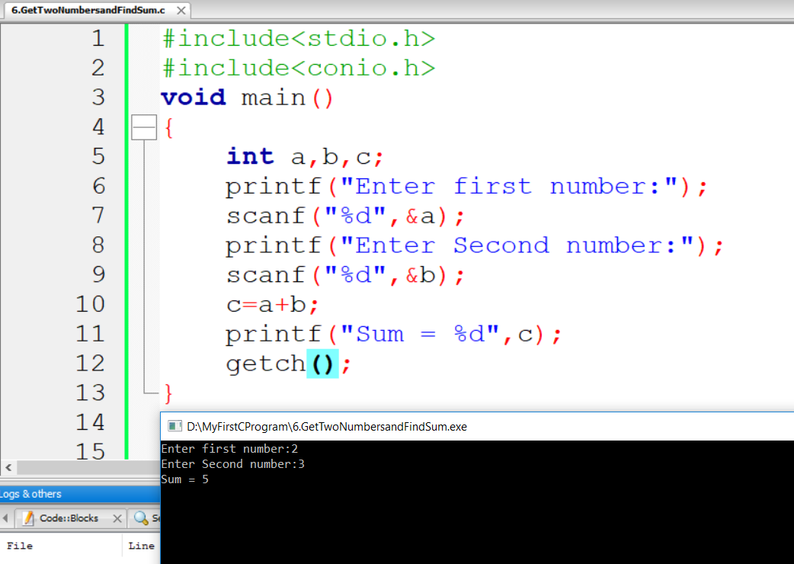
We declare 3 variables.
Read 1st number
Read 2nd number
Adding two numbers
and storing the result
in c.
We print the result
a, b = operands
+ = operator
In C Language, there are many operator which performs
operation between operands

Slide 3

Operator in C
Type | Operator
Arithmetic Operator | +, -, *, /, %
Relational Operator | ==, !=, >, <, >=, <=
Logical Operator | &&, ||, !
Bitwise Operator | &, |, ^
Shift Operator | <<, >>
Unary Operator | ++, --
Assignment Operator | =, +=, -= etc.,

Slide 4

Arithmetic Operator
Operator | Purpose | Example
+ | Addition | 6+5 = 11
- | Subtraction | 7-2 = 5
* | Multiplication | 3*2 = 6
/ | Division | 6/3 = 2
% | Module Division | 6%3 = 0

Slide 5
Relational Operator
Operator | Read As | Example
== | Equal to | If(a==b)
!= | Not equal to | 5!=3
> | Greater than | 7>3
< | Less than | 3<5
>= | Greater than or equal to | 5>=5
<= | Less than or equal to | 9<=12

Slide 6
Logical Operator
Operator | Description | Example
&& | Logical AND | If(a==5 && b==8)
|| | Logical OR | If(a==5 || b==8)
! | Logical NOT | If(!degree)
&& | TRUE | FALSE
TRUE | TRUE | FALSE
FALSE | FALSE | FALSE
|| | TRUE | FALSE
TRUE | TRUE | TRUE
FALSE | TRUE | FALSE

Slide 7

Bitwise Operators
Operator | Purpose | Example
& | Bitwise AND | 6&3 = 2
| | Bitwise OR | 6|3 = 7
^ | Bitwise XOR | 6^3 = 5

Slide 8
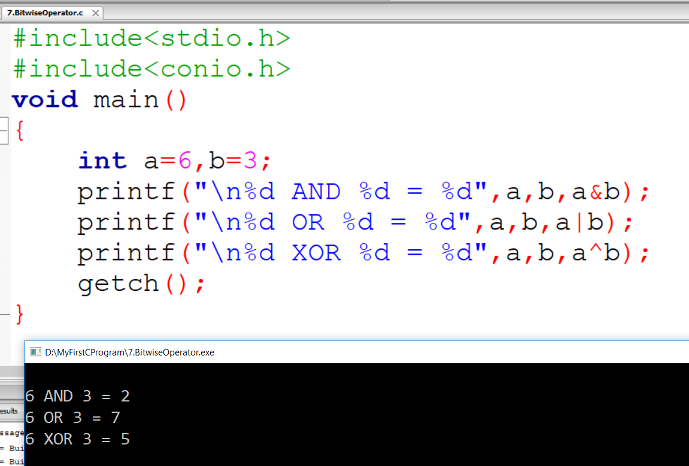

Slide 9

Shift Operator
Operator | Purpose | Example
<< | Left Shift | 6<<2=24
>> | Right Shift | 6>>2 = 1

Slide 10
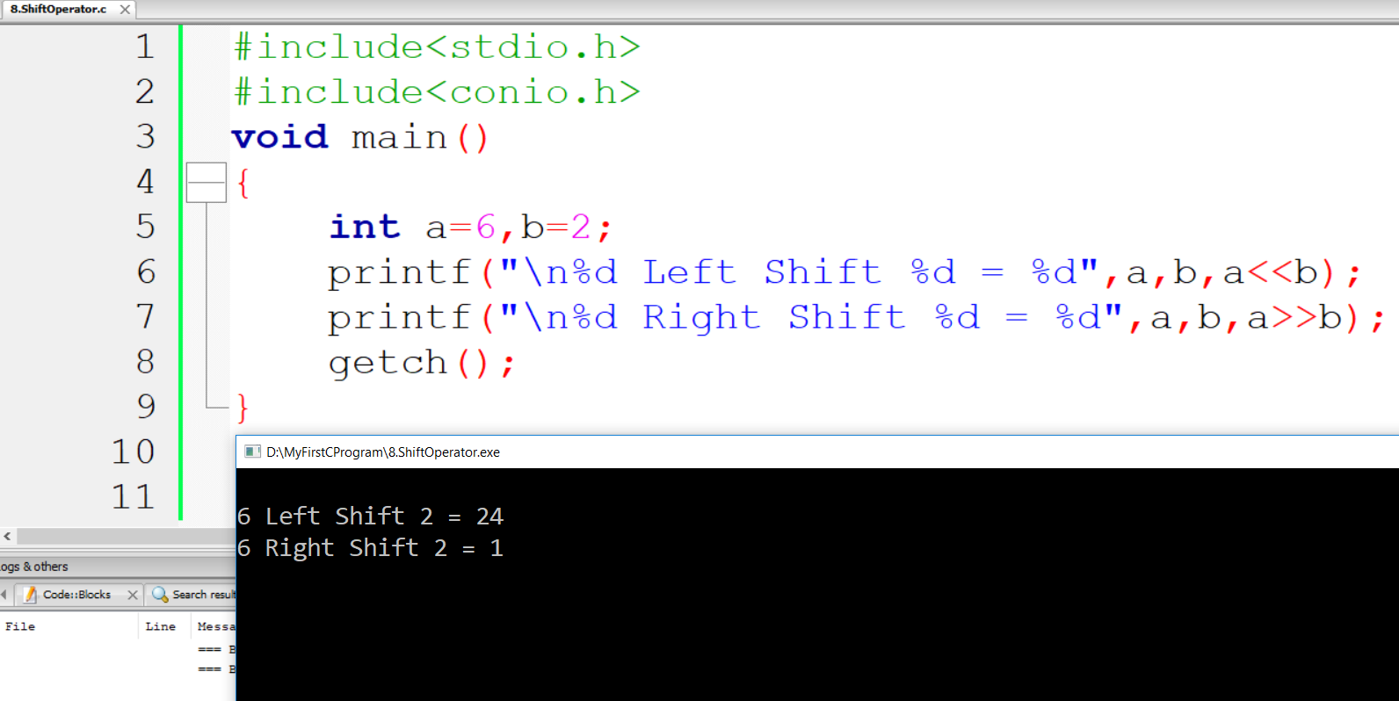

Slide 11
Unary Operator
Post-Increment / Post-Decrement | Pre-Increment / Pre-Decrement
i=7; i++; printf(“%d,i); | i=7; ++i; printf(“%d,i);
Int i,j; i=5; j=i++; printf(“%d”,i); printf(“%d”,ij; | Int i,j; i=5; J=++i; printf(“%d”,i); printf(“%d”,ij;
Int ij; i=8; J=i--; printf(“%d”,i); printf(“%d”,ij; | Int ij; i=8; J=--i; printf(“%d”,i); printf(“%d”,ij;

Slide 12
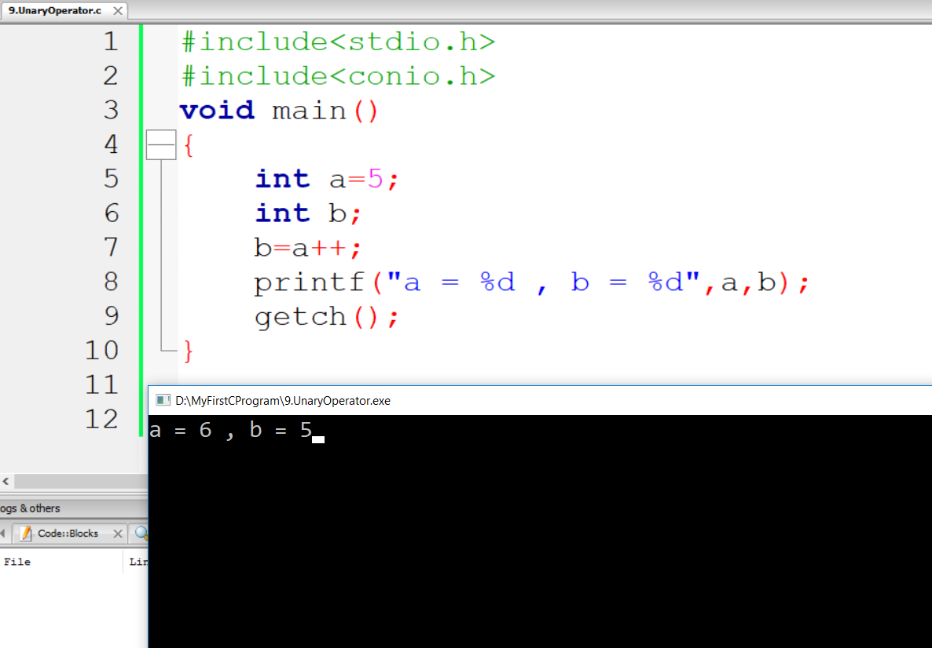

Slide 13

Assignment Operator
Operator | Example | Result
= | int a=5,b=4; A=b; printf(“%d %d”,a,b); | 4 4
+= | int a=5,b=4; a+=b; printf(“%d %d”,a,b); | 9 4
-= | int a=5,b=4; A-=b; printf(“%d %d”,a,b); | 1 4

Slide 14
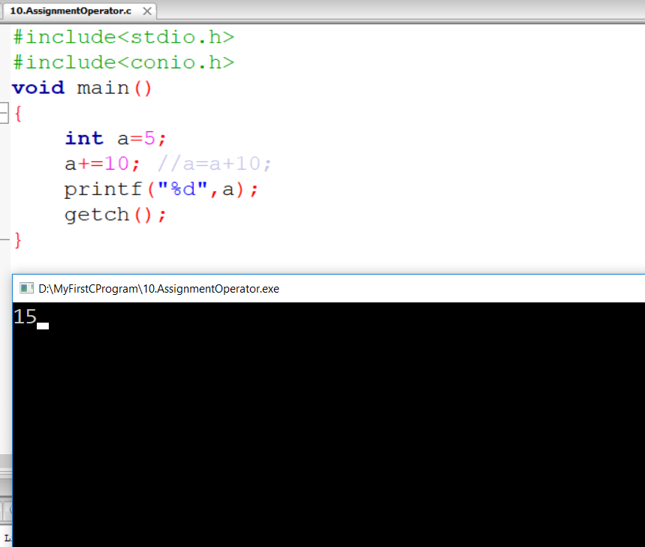

Slide 15

Next Class
Control Structures in
C Programming

Slide 16

To Be Continued…………
Thank You!

